Slide 1
Welcome
To presentation

Slide 2
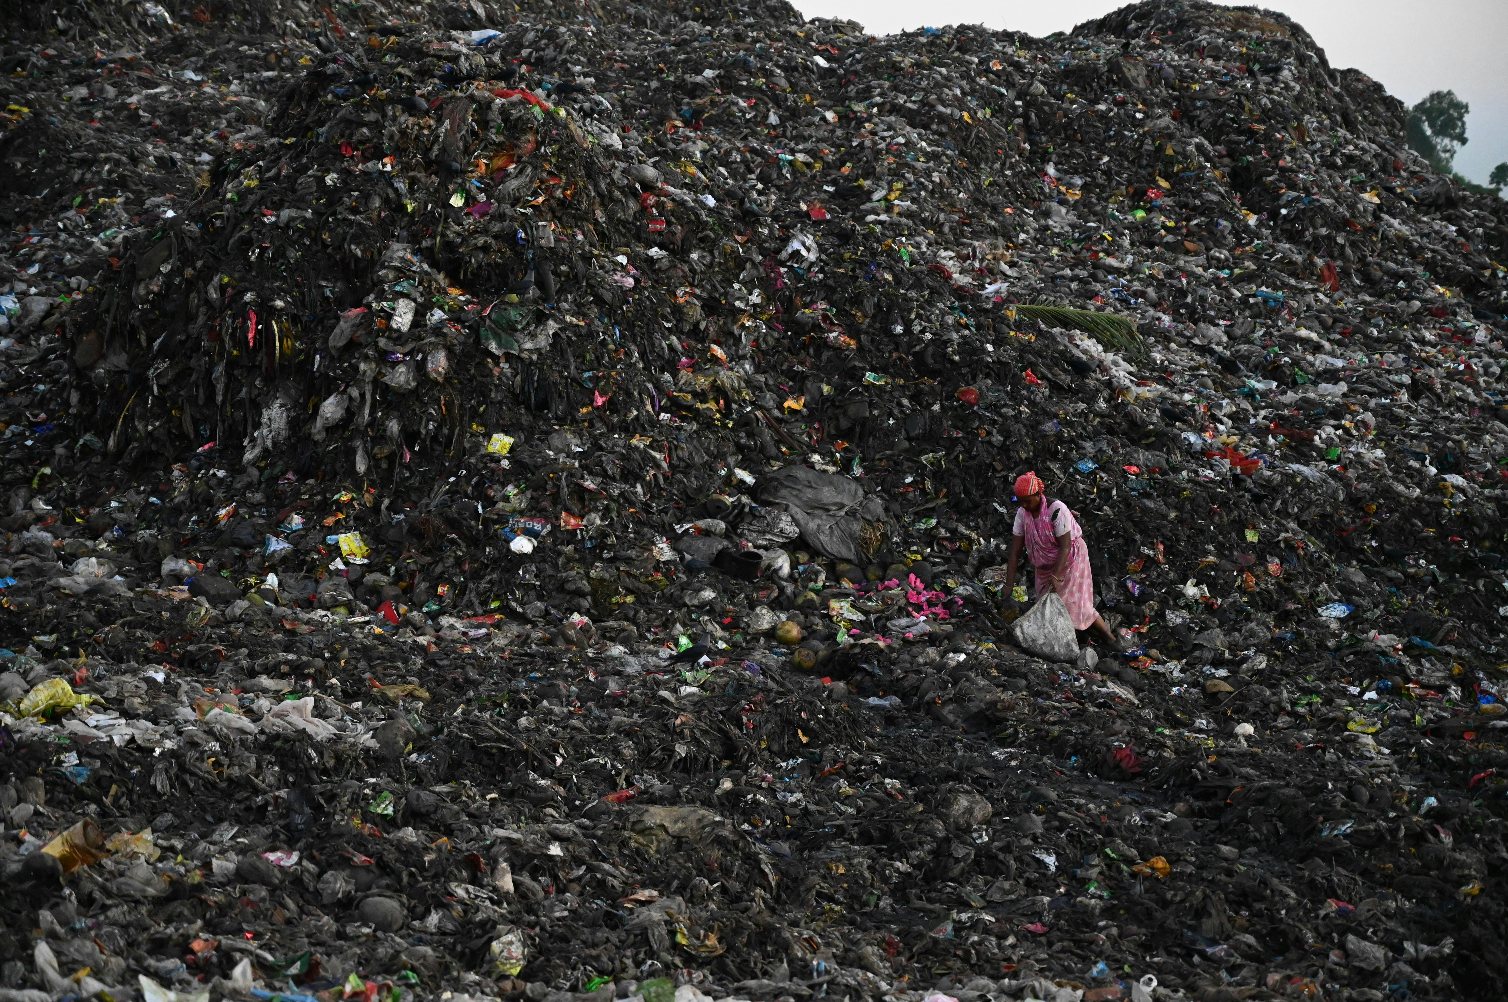
World Environment Pollution: Causes, Impacts, and Mitigation Strategies
This presentation explores the multifaceted issue of environmental pollution, delving into its causes, consequences, and potential solutions.

Slide 3
Understanding the Scope of Environmental Pollution
Global Challenge
Complex Interplay
Environmental pollution is a pervasive global issue impacting air, water, soil, and ecosystems worldwide.
Pollution stems from various sources, including industrial activity, transportation, agriculture, and urbanization, creating a complex web of interconnected problems.

Slide 4
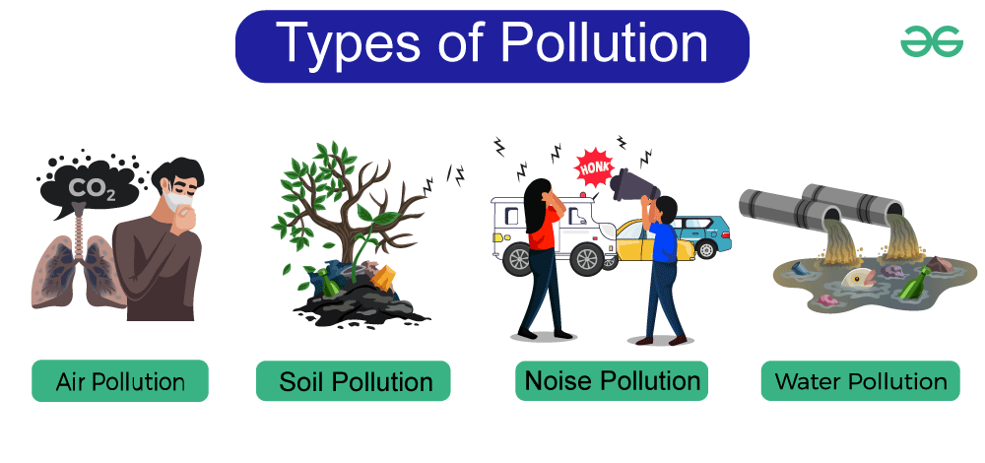




Examining the Primary Sources of Pollution Worldwide
Industrial Emissions
Vehicle Exhaust
Manufacturing processes release harmful pollutants into the air, water, and soil.
Combustion engines emit greenhouse gases and particulate matter, contributing to air pollution.
Waste Management
Agricultural Runoff
Improper waste disposal and landfill practices contaminate soil and water resources.
Fertilizers and pesticides used in agriculture can pollute waterways and impact water quality.

Slide 5

Evaluating the Environmental and Public Health Consequences
1
Climate Change
2
Water Contamination
Greenhouse gas emissions contribute to global warming and climate change, impacting weather patterns and natural disasters.
Polluted water sources threaten human health and endanger aquatic life, leading to waterborne diseases.
3
Biodiversity Loss
4
Respiratory Diseases
Pollution degrades habitats and ecosystems, leading to the extinction of species and the loss of biodiversity.
Air pollution causes respiratory problems and other health issues, particularly in urban areas.

Slide 6
Exploring Innovative Solutions and Sustainable Practices
Renewable Energy
1
Transitioning to renewable energy sources, like solar and wind power, reduces carbon emissions.
Waste Reduction and Recycling
2
Implementing effective waste management programs and promoting recycling helps reduce pollution.
Sustainable Agriculture
3
Adopting sustainable farming practices, like organic farming and reduced pesticide use, minimizes pollution.

Slide 7

Conclusion and Call to Action
Addressing environmental pollution requires collective action, individual responsibility, and innovative solutions.

Slide 8
Thank You

